Slide 1
Geographic Oversampling for Race/Ethnicity Using Data from the 2010 Census
Presented to WSS
  Sixia Chen
  December 3, 2014

Slide 2
Overview
A number of surveys are carried out to study the characteristics of specific race/ethnicity domains.
  2011-2014 National Health and Nutrition Examination Survey (NHANES): more than 60 domains by using Blacks, Hispanics and Asians.
  2014 Minnesota Survey on Adult Substance Use (MNSASU): Blacks, Asians, American Indians and Hispanics.
  2013-2014 California Health Interview Survey (CHIS): Latinos, Vietnamese, Koreans, and American Indians/Alaska Natives.

Slide 3
Overview (cont.)
Various sampling approaches for sampling minorities:
  Oversample strata defined by the geographic areas where the minority is more concentrated, such as 2014 MNSASU.
  Using Asian and Hispanics surname files (sometimes first names also), such as 2010 CHIS, 2014 MNSASU.
  Others.

Slide 4
Geographic Oversampling
This presentation focus on geographic oversampling.
Waksberg, Judkins, and Massey (1997) evaluated the effectiveness of geographic oversampling based on data from the 1990 Census.
This presentation updates the Waksberg et al. results using the 2010 Census, and extends the results to subdivisions of the country and oversampling multiple minorities simultaneously.

Slide 5
Outline
Basic theoretical results.
Comparisons of the effectiveness of geographic oversampling in 1990 and 2010 at the national level for Blacks, Hispanics, Asians, and American Indians/Alaska Natives (AI/AN).
An investigation of different cut-points of the minority prevalence in forming the strata.
Application of the approach to Census regions and to Core Based Statistical Areas (CBSAs) and non-CBSAs.
Some approaches for oversampling multiple domains.
Limitations and conclusions.

Slide 6
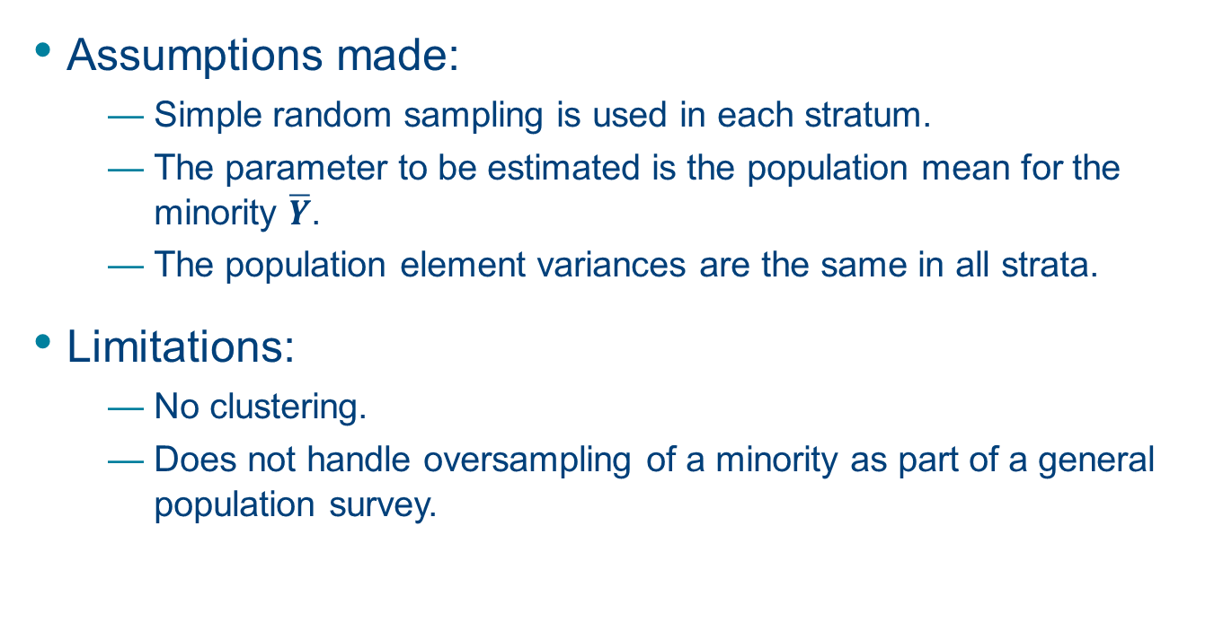
Underlying Assumptions
Assumptions made:
  Simple random sampling is used in each stratum.
  The parameter to be estimated is the population mean for the minority $\overline{Y}$.
  The population element variances are the same in all strata.
Limitations:
  No clustering.
  Does not handle oversampling of a minority as part of a general population survey.

Slide 7
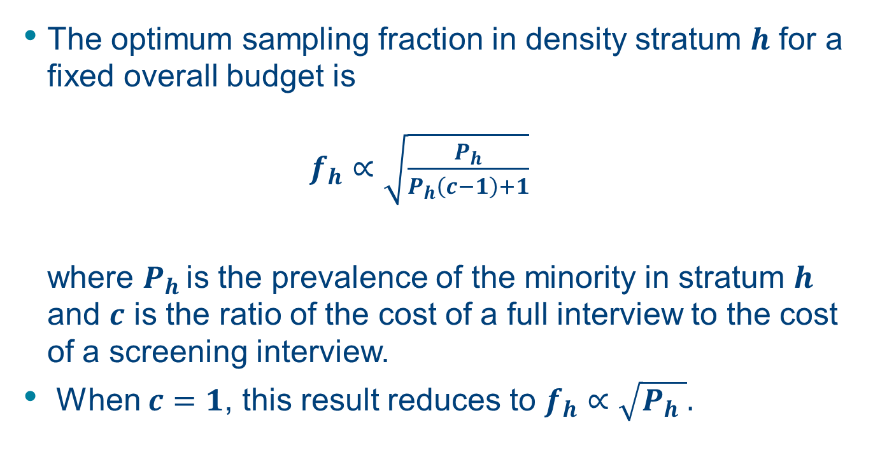
Theoretical Results (Kalton and Anderson, 1986)
The optimum sampling fraction in density stratum $h$ for a fixed overall budget is
$f_{h}∝\sqrt{\frac{P_{h}}{P_{h}\left(c−1\right)+1}}$
where $P_{h }$is the prevalence of the minority in stratum $h$ and $c$ is the ratio of the cost of a full interview to the cost of a screening interview.
When $c=1$, this result reduces to $f_{h}∝\sqrt{P_{h} }.$

Slide 8
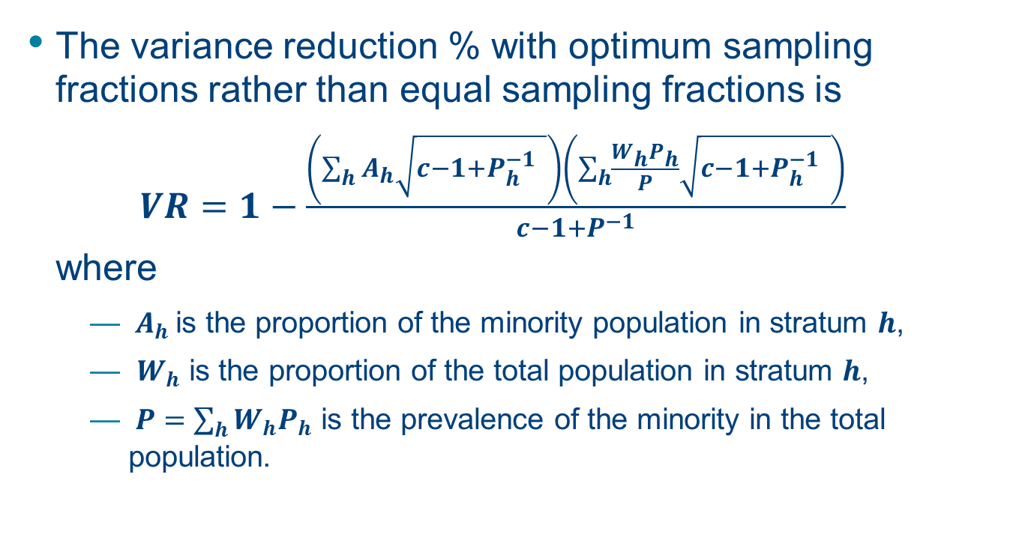
Theoretical Results (cont.)
The variance reduction % with optimum sampling fractions rather than equal sampling fractions is
$VR=1−\frac{\left(\sum_{h}{A_{h}\sqrt{c−1+P_{h}^{−1} }}\right)\left(\sum_{h}{\frac{W_{h}P_{h}}{P}\sqrt{c−1+P_{h}^{−1} }}\right)}{c−1+P^{−1}}$
where
  ${ A}_{h}$is the proportion of the minority population in stratum $h$,
  $W_{h}$ is the proportion of the total population in stratum $h$,
  $P=\sum_{h}{W_{h}P_{h}}$ is the prevalence of the minority in the total population.

Slide 9
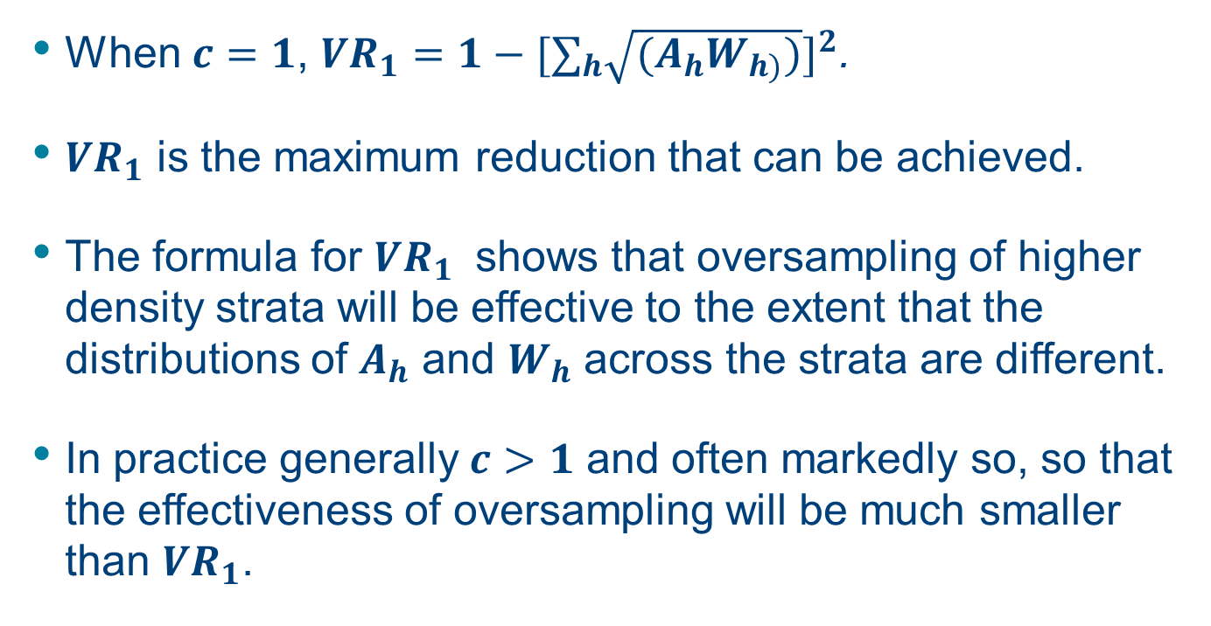
Theoretical Results (cont.)
When $c=1$, $VR_{1}=1−{[∑_{h}\sqrt{{(A}_{h}W_{h)})}]}^{2}$.
$VR_{1}$ is the maximum reduction that can be achieved.
The formula for $VR_{1}$ shows that oversampling of higher density strata will be effective to the extent that the distributions of $A_{h}$ and $W_{h}$ across the strata are different.
In practice generally $c>1$ and often markedly so, so that the effectiveness of oversampling will be much smaller than $VR_{1}$.

Slide 10
Effectiveness of Oversampling in 1990 and 2010
The results presented are for density strata based on minority densities in (1) Census blocks and (2) Census block groups (BGs).
For comparability the same density strata definitions are used for both years.
The 1990 Census question asked for only a single race, whereas the 2010 question allowed for multiple races. The 2010 results reported here are for those who responded only the specified race (e.g., Blacks alone).

Slide 11
Effectiveness of Oversampling in 1990 and 2010 (cont.)
The numbers of block was about 25 percent larger in 2010 than in 1990 whereas the number of block groups declined slightly.
The Hispanic and Asian minorities are far more prevalent in 2010 than they were in 1990.
The comparative results are for single race and all ages; later results are for a given race for adults aged 18 and over.

Slide 12
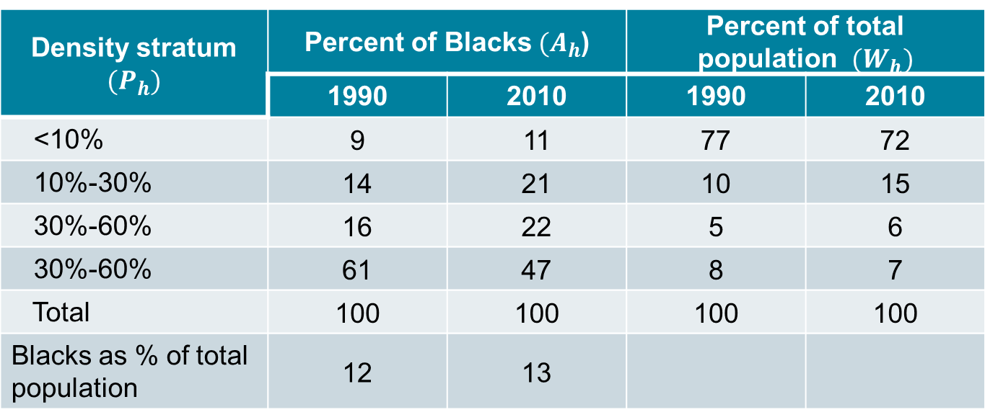
Clustering of Blacks by Blocks, 1990 and 2010
Density stratum ${(P}_{h})$ | Percent of Blacks${(A}_{h}$) |  | Percent of total population ${(W}_{h})$
 | 1990 | 2010 | 1990 | 2010
<10% | 9 | 11 | 77 | 72
10%-30% | 14 | 21 | 10 | 15
30%-60% | 16 | 22 | 5 | 6
30%-60% | 61 | 47 | 8 | 7
Total | 100 | 100 | 100 | 100
Blacks as % of total population | 12 | 13

Slide 13
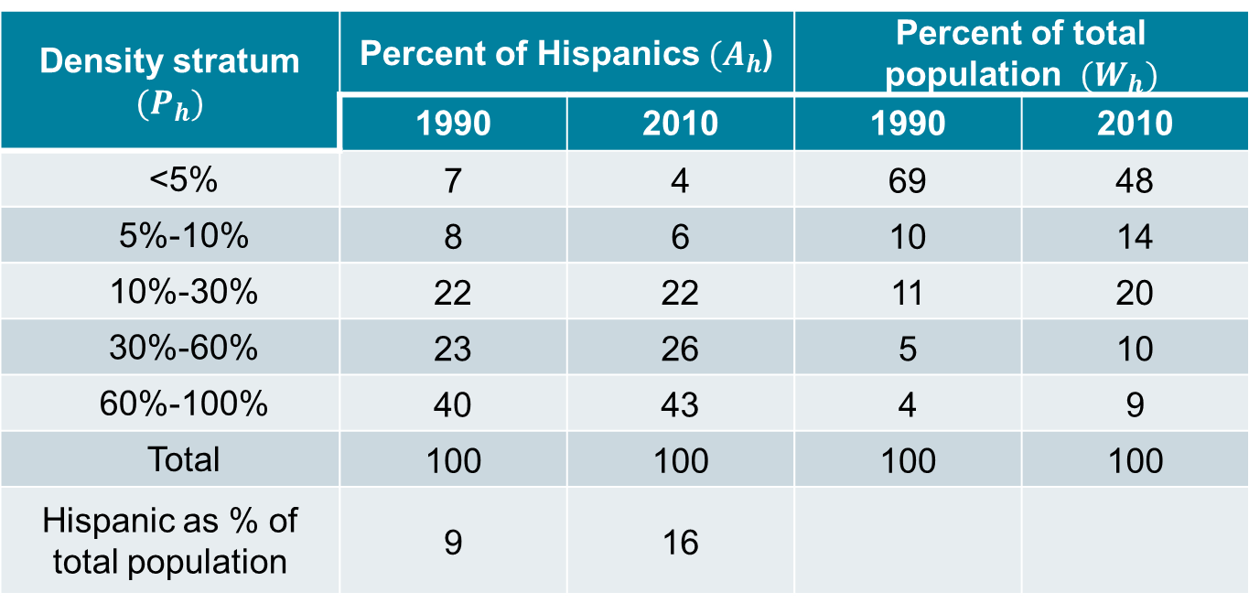
Clustering of Hispanics by Blocks in 1990 and 2010
Density stratum ${(P}_{h})$ | Percent of Hispanics ${(A}_{h}$) |  | Percent of total population ${(W}_{h})$
 | 1990 | 2010 | 1990 | 2010
<5% | 7 | 4 | 69 | 48
5%-10% | 8 | 6 | 10 | 14
10%-30% | 22 | 22 | 11 | 20
30%-60% | 23 | 26 | 5 | 10
60%-100% | 40 | 43 | 4 | 9
Total | 100 | 100 | 100 | 100
Hispanic as % of total population | 9 | 16

Slide 14
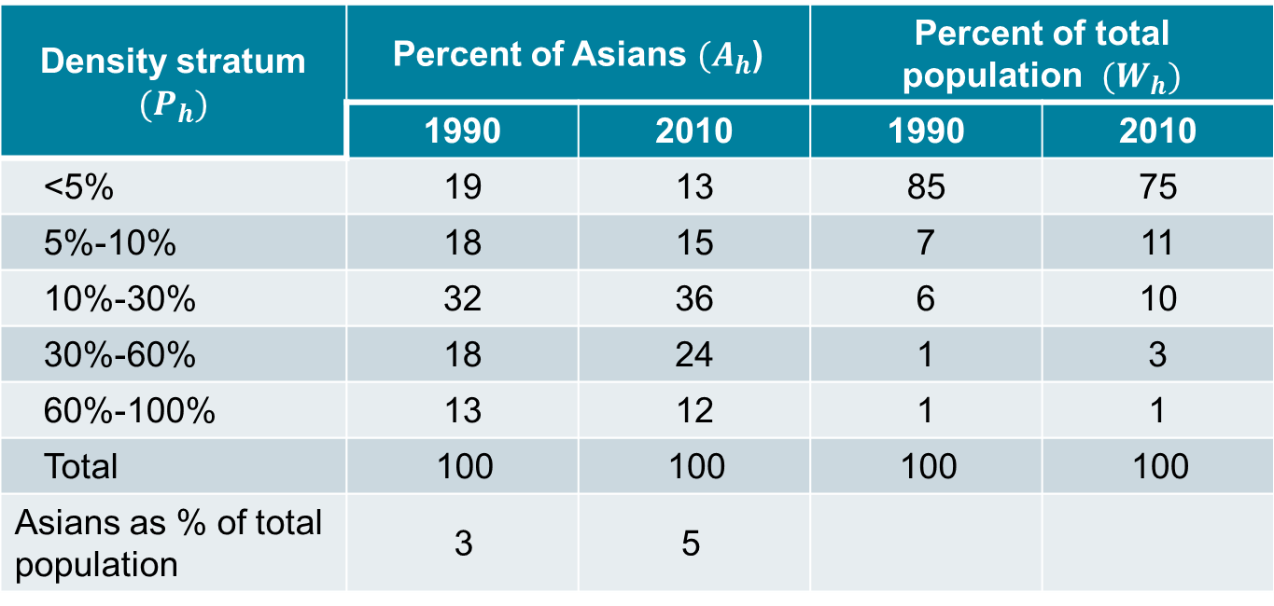
Clustering of Asians¹ by Blocks, 1990 and 2010
Density stratum ${(P}_{h})$ | Percent of Asians ${(A}_{h}$) |  | Percent of total population ${(W}_{h})$
 | 1990 | 2010 | 1990 | 2010
<5% | 19 | 13 | 85 | 75
5%-10% | 18 | 15 | 7 | 11
10%-30% | 32 | 36 | 6 | 10
30%-60% | 18 | 24 | 1 | 3
60%-100% | 13 | 12 | 1 | 1
Total | 100 | 100 | 100 | 100
Asians as % of total population | 3 | 5
¹Asians, Native Hawaiians, and other Pacific Islanders

Slide 15
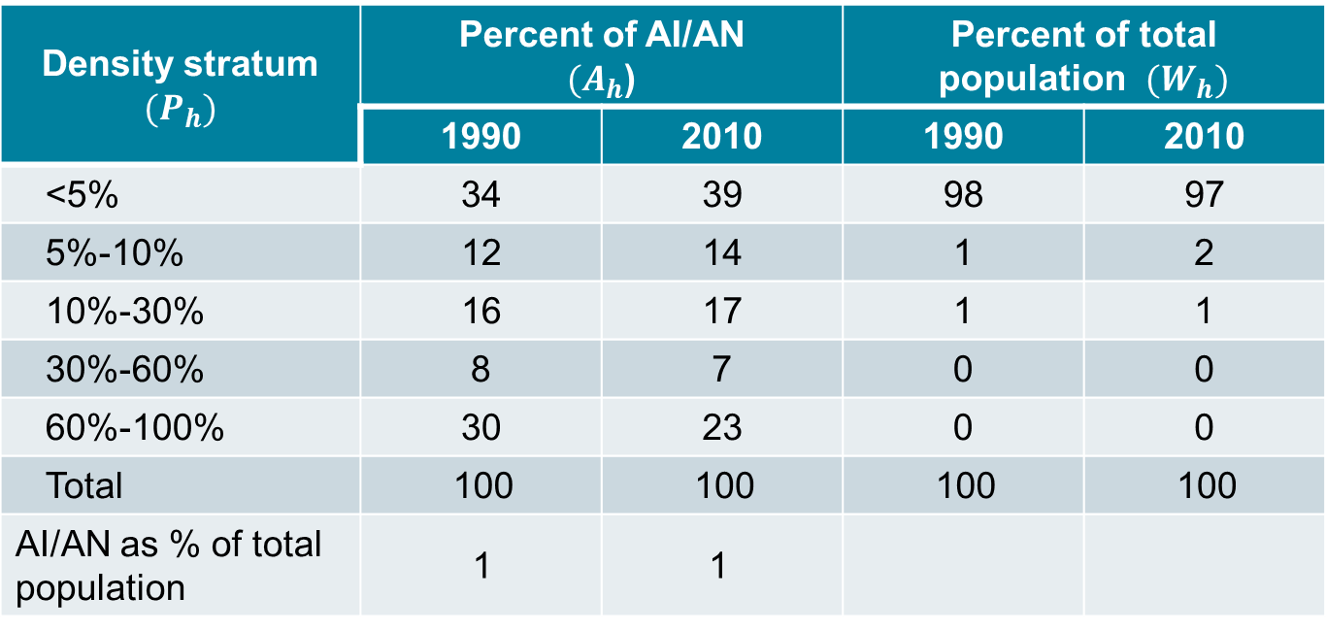
Clustering of AI/AN by Blocks, 1990 and 2010
Density stratum ${(P}_{h})$ | Percent of AI/AN ${(A}_{h}$) |  | Percent of total population ${(W}_{h})$
 | 1990 | 2010 | 1990 | 2010
<5% | 34 | 39 | 98 | 97
5%-10% | 12 | 14 | 1 | 2
10%-30% | 16 | 17 | 1 | 1
30%-60% | 8 | 7 | 0 | 0
60%-100% | 30 | 23 | 0 | 0
Total | 100 | 100 | 100 | 100
AI/AN as % of total population | 1 | 1

Slide 16
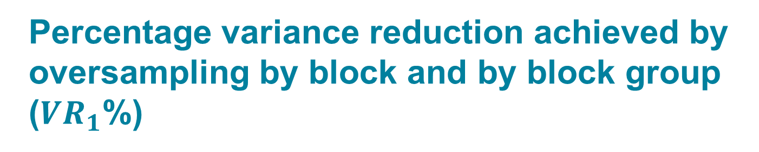
Percentage variance reduction achieved by oversampling by block and by block group ($VR_{1}$%)
Minority | 1990 Block | 2010 Block | 1990 BG | 2010 BG
Black | 53 | 44 | 45 | 36
Hispanic | 51 | 39 | 43 | 31
Asian | 47 | 45 | 36 | 33
AI/AN | 52 | 45 | 39 | 29

Slide 17
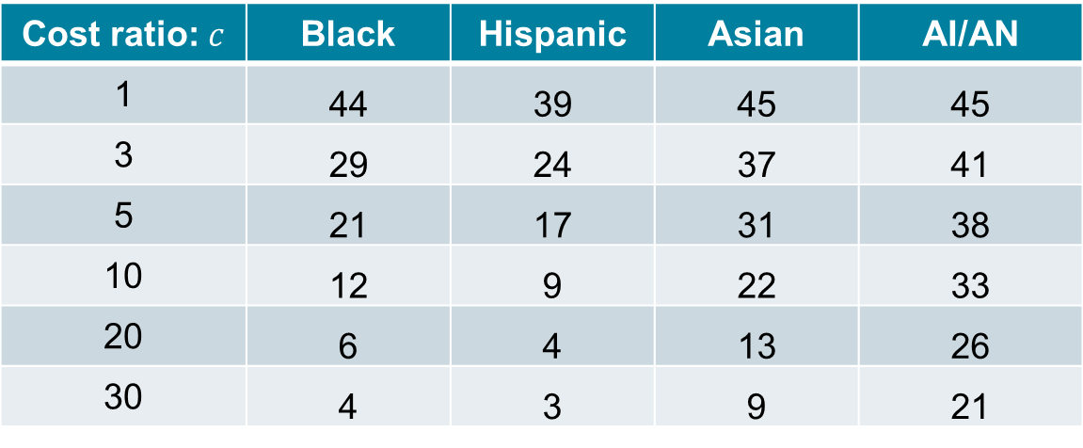

Values of $VR$% achieved by oversampling for different values of $c$, 2010 block data (all ages, single race)
Cost ratio: $c$ | Black | Hispanic | Asian | AI/AN
1 | 44 | 39 | 45 | 45
3 | 29 | 24 | 37 | 41
5 | 21 | 17 | 31 | 38
10 | 12 | 9 | 22 | 33
20 | 6 | 4 | 13 | 26
30 | 4 | 3 | 9 | 21

Slide 18
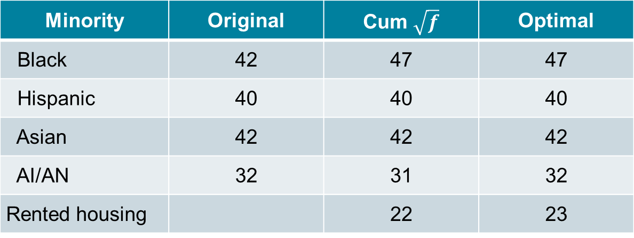
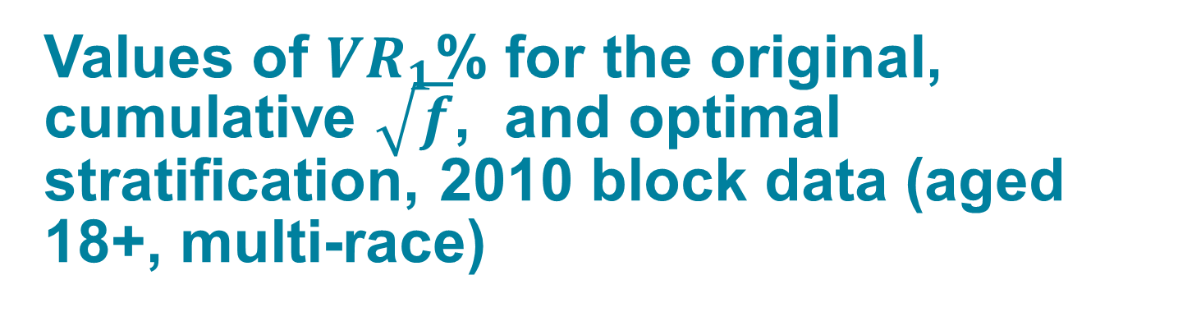
Values of $VR_{1}$% for the original, cumulative $\sqrt{f}$, and optimal stratification, 2010 block data (aged 18+, multi-race)
Minority | Original | Cum $\sqrt{f}$ | Optimal
Black | 42 | 47 | 47
Hispanic | 40 | 40 | 40
Asian | 42 | 42 | 42
AI/AN | 32 | 31 | 32
Rented housing |  | 22 | 23

Slide 19

Values of $VR_{1}$% in subpopulations with optimal stratification, 2010 block data
 | Black | Hispanic | Asian | AI/AN
National | 47 | 40 | 42 | 32
Northeast | 47 | 40 | 40 | 17
Midwest | 55 | 45 | 41 | 35
South | 40 | 41 | 37 | 32
West | 35 | 25 | 34 | 31
CBSA | 45 | 39 | 41 | 27
Non-CBSA | 71 | 61 | 49 | 64

Slide 20
Clustering of Blacks in Non-CBSAs,
2010 Block Data
Density stratum | Percent of Blacks | Percent of total population
<5% | 3 | 82
5%-10% | 3 | 4
10%-25% | 9 | 4
25%-50% | 17 | 4
50%-100% | 68 | 7
Total | 100 | 100
Blacks as % non- CBSA population | 8

Slide 21
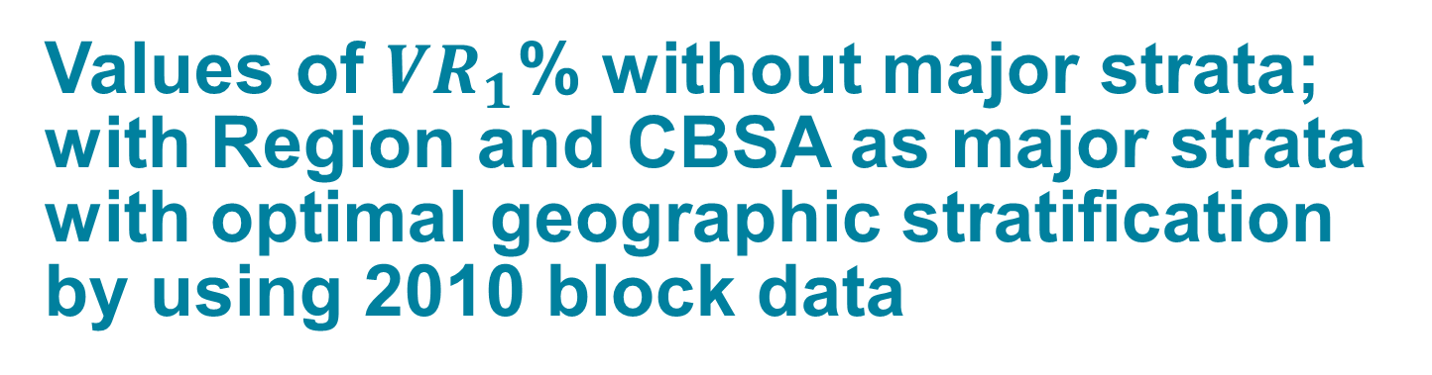
Values of $VR_{1}$% without major strata; with Region and CBSA as major strata with optimal geographic stratification by using 2010 block data
Strata | Black | Hispanic | Asian | AI/AN
None | 47 | 40 | 42 | 32
Region | 44 | 35 | 37 | 31
CBSA/non-CBSA | 46 | 39 | 41 | 32
Region X Density | 47 | 40 | 42 | 33
CBSA/non-CBSA X Density | 47 | 40 | 43 | 32

Slide 22
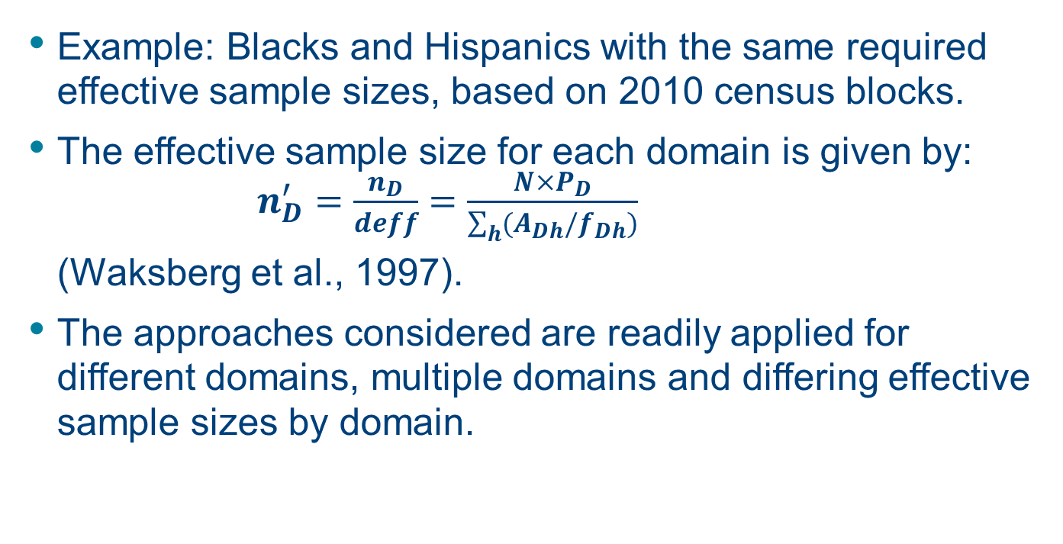
Estimating Parameters for Multiple Domains
Example: Blacks and Hispanics with the same required effective sample sizes, based on 2010 census blocks.
The effective sample size for each domain is given by:
$n_{D}^{′}=\frac{n_{D}}{deff}=\frac{N×P_{D}}{\sum_{h}{(A_{Dh}/f_{Dh})}}$
(Waksberg et al., 1997).
The approaches considered are readily applied for different domains, multiple domains and differing effective sample sizes by domain.

Slide 23
Simple Random Sampling (SRS)
Under this equal probability design, the effective sample size is equal to the actual sample size for both domains.
Select screening sample of the size needed to produce the desired sample size for the rarer of the two domains (Blacks in this case).
Sample all members of the rarer domain, but sample only a fraction of the less rare domain (the remainder receiving only the screening interview).

Slide 24
Combined Density Stratification (CDS)
Construct separate sets of five strata for Blacks and Hispanics, applying the optimum stratification procedure.
The cross-classification of these strata resulted in 25 cells which are then taken as the final strata.
The sampling fractions within each of the final strata are computed together with the effective sample size requirement for each domain separately.
The higher of the two domain sampling fractions is applied in each of the final strata.
All those sampled from the rarer domain are included in the sample, but only a fraction of the sample in the other domain is retained.

Slide 25
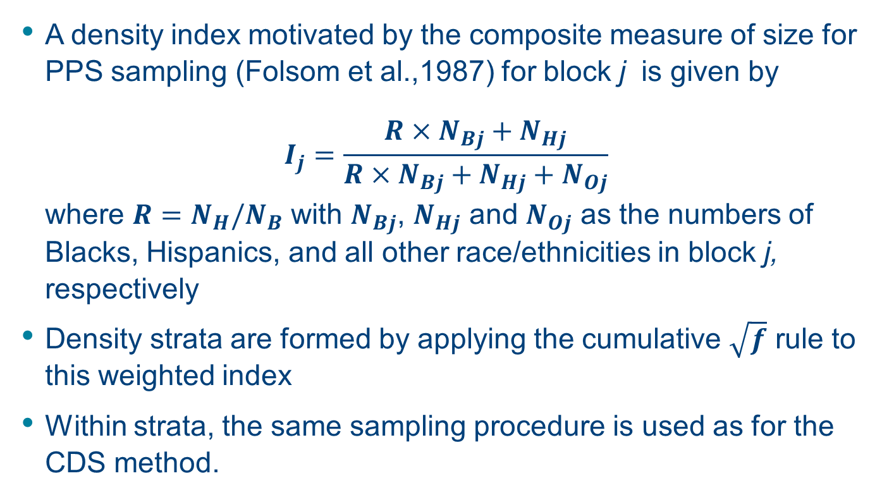
Weighted Density Stratification (WDS)
A density index motivated by the composite measure of size for PPS sampling (Folsom et al.,1987) for block j is given by
$$I_{j}=\frac{R×N_{Bj}+N_{Hj}}{R×N_{Bj}+N_{Hj}+N_{Oj}}$$
where $R=N_{H}/N_{B}$ with $N_{Bj}$, $N_{Hj}$ and $N_{Oj}$ as the numbers of Blacks, Hispanics, and all other race/ethnicities in block j, respectively
Density strata are formed by applying the cumulative $\sqrt{f}$ rule to this weighted index
Within strata, the same sampling procedure is used as for the CDS method.

Slide 26
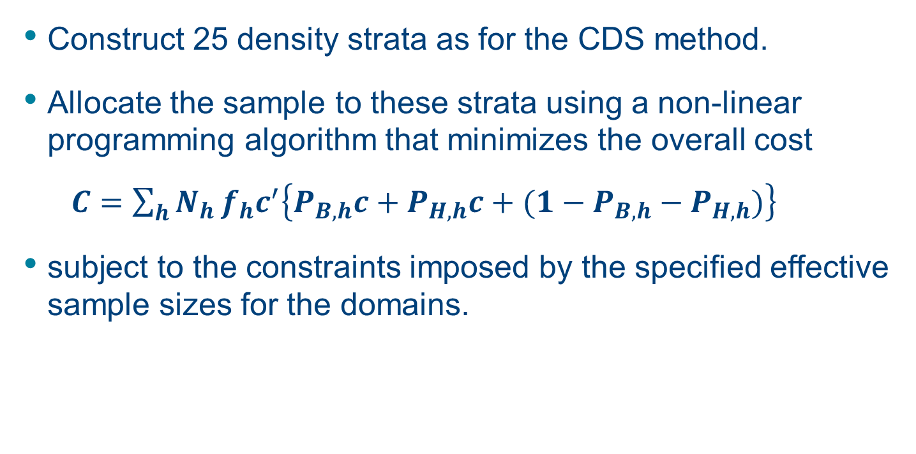
Nonlinear Programming Method (NLP)
Construct 25 density strata as for the CDS method.
Allocate the sample to these strata using a non-linear programming algorithm that minimizes the overall cost
$C=\sum_{h}{N_{h}}f_{h}c^{′}\left\{P_{B,h}c+P_{H,h}c+(1−P_{B,h}−P_{H,h})\right\}$
subject to the constraints imposed by the specified effective sample sizes for the domains.

Slide 27
Percentage cost reduction compared with SRS by geographic oversampling using the three alternative methods for different values of c
Cost ratio, c | DDS | WDS | NLP
1 | 27 | 33 | 37
3 | 13 | 17 | 20
5 | 8 | 11 | 13
10 | 4 | 5 | 7
20 | 1 | 2 | 3
30 | 1 | 1 | 2

Slide 28

Values of $VR_{1}$% by geographic oversampling using the three alternative methods
Method | Blacks | Hispanics
DDS | 27 | 15
WDS | 33 | 23
NLP | 37 | 27
Single domain | 47 | 40

Slide 29
Limitations
The variance reductions will be lower later in the decade (Waksberg et al.,1997).
The multiple domain approaches are work in progress. Further research is needed in this area.
The basic theory assumes a single stage sample with SRS within the density strata. There is a need to consider complex sample designs. See Clark (2009).

Slide 30
Conclusions
Geographic oversampling remains a useful method for sampling minority populations, although the gains are smaller than they were in 1990.
The variance reductions do vary by region and are particularly large for all minorities in non-CBSAs.
The choice of cut-points seems be fairly robust to departures from the optimum cut-points.
Stratification by region and by CBSA/non-CBSA do not add much benefit after oversampling minorities.
Of the three approaches examined for oversampling more than one minority, the NLP method performed the best.

Slide 31
References
Clark, R. G. (2009). Sampling of subpopulations in two-stage surveys. Statistics in Medicine, 28:3697–3717.
Folsom, R.E., Potter, F.J. and Williams, S.K. (1987). Notes on a composite size measure for self-weighting samples in multiple domains. Proceedings of the Section on Survey Research Methods, American Statistical Association, 792-796.
Kalton, G. and Anderson, D. W. (1986). Sampling rare populations. Journal of the Royal Statistical Society. Series A, 149, 65-82.
Waksberg, J., Judkins, D. and Massey, J.T. (1997). Geographic-based oversampling in demographic surveys of the United States. Survey Methodology, 23, 61-71.

Slide 32
Thank You
sixiachen@westat.com

